Slide 1
Auburn-USDA CS Clinic
Liaison Meeting (2/13/25)

Slide 2
Travel Plans Updates
Rehash meeting with Morgan yesterday, reserved van for journey
Confirmed dates/times
Planned stay at (hotel name)
Other logistics (do we need to book the citrus farm etc.)?

Slide 3
Program Blurb
We would like your feedback on our rough draft before Monday, will email it with the meeting notes.
Guidelines are 60-80 words (last year’s blurb was about 120)

Slide 4
GUI Progress
Mehrezat – Dynamic label text
Devanshi – settings button, toggling colors, gridlines, labels and visibility

Slide 5
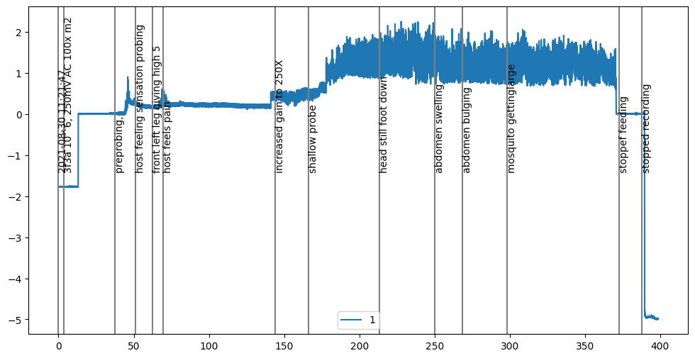
WinDaq Comment Importation

Slide 6
CRFs and Standardized Benchmarking
CRFs are really slow, need to rethink how we should use them
Made a script to benchmark data in a standardized way
Automatically generates all the relevant plots and statistics we want
Precision, Recall, F1, Accuracy
Confusion Matrix
Plots showing difference between actual and predicted labels

Slide 7
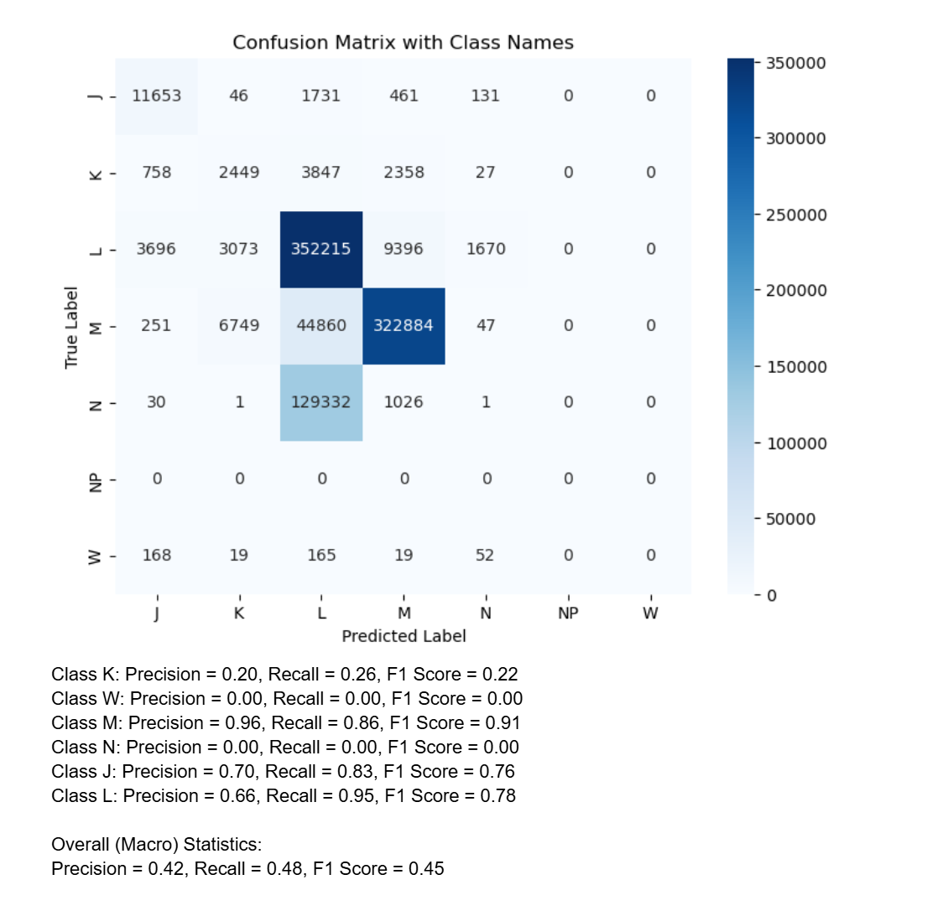
UNet Cleanup
Cleaned up Unet code, fixed some small issues with plots
Set up “data leak splitter” and “simple splitter” as preprocessing steps
Tested on voltage only and voltage + clasp
Preliminary: data leak splitter + voltage only is best

Slide 8
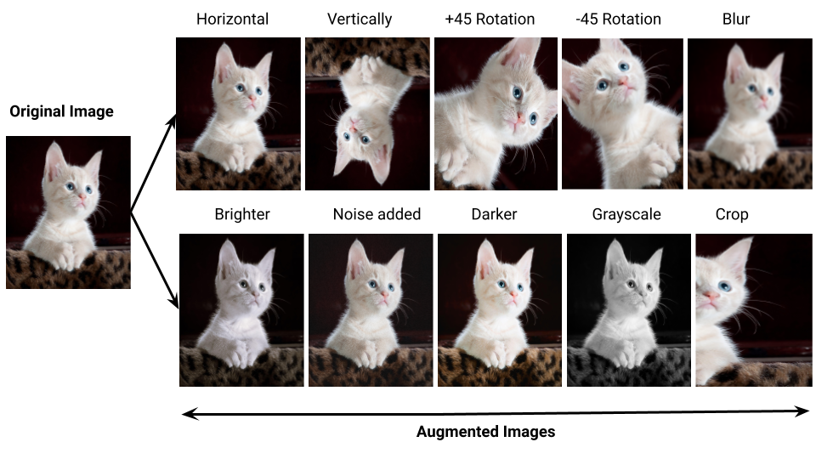
Questions about Data Augmentation
What are some biologically reasonable constants for a dataset?
Could we cut out a segment for on file and cut in another segment from a different file?

